Slide 1
The association between L1 transfer, L2 proficiency, L2 use and visuospatial prediction and morphophonological prediction
Laura Fernández Arroyo
Rutgers University
January 21, 2021
Notes:
Hello everyone. Thank you all for attending my dissertation defense. In my dissertation project I have addressed several issues in L1 and L2 morphophonological prediction. Specifically, the role of language experience factors and the association of morphophonological prediction with non-linguistic visuospatial prediction.

Slide 2
To predict…
Notes:
What may be common in these images? RESPONSE Predicting when beats happen to synchronize, predict trajectory…
Prediction is the preactivation of incoming elements based on information we already have through the use of probabilistic associations.
SOMETIMES WE MAKE CORRECT PREDICTIONS, LIKE THIS PERSON CATCHING A BALL…

Slide 3
…or not to predict
Notes:
AND OTHER TIMES WE DON’T. For instance in an L2 cues differ…
WE MAKE PREDICTIONS IN A VARIETY OF DOMAINS: E.G., VISUOSPATIAL, LIKE WHEN WE CATCH A BALL, AUDITORY, LIKE WHEN GUESSING THE NEXT NOTE IN A MELODY, LINGUISTIC, LIKE WHEN PREDICTING A WORD’S ENDING.

Slide 4
Goals
ASSOCIATION BETWEEN VISUOSPATIAL AND LINGUISTIC PREDICTION
LANGUAGE FACTORS AFFECTING LINGUISTIC PREDICTION:
L1
L2 proficiency
L2 use
Notes:
ONE OF MY QUESTIONS IS WHETHER THE WAY WE PREDICT IN ONE COGNITIVE DOMAIN (E.G., VISUOSPATIAL) IS ASSOCIATED WITH THE WAY WE PREDICT IN ANOTHER COGNITIVE DOMAIN (E.G., LINGUISTIC). THIS IS IMPORTANT BECAUSE DOMAIN-SPECIFIC THEORIES CLAIM THAT COGNITIVE DOMAINS ARE INDEPENDENT FROM EACH OTHER, WHEREAS DOMAIN-GENERAL THEORIES ARGUE THAT ALL DOMAINS ARE RELATED TO EACH OTHER.
MY OTHER QUESTION IS WHAT LANGUAGE FACTORS AFFECT PREDICTION WHEN WE NEED TO PREDICT IN A NON-NATIVE LANGUAGE. LET’S FOCUS ON LINGUISTIC PREDICTION FIRST.
Laura, deja este orden pq el primer bullet es la transición con slide 3. El principio de tu presentación se siente como una copia de la presentación de Cristina. Yo cambiaría slides 2 y 3 a un slide de alguien q predice en diferentes domains: driving a car (e.g., passing a traffic light that just turned red), catching a ball, etc. pq esto es lo DIFERENTE de tu tesis. Si no, la audiencia siente q es un mero follow-up de la tesis de Cristina, un comentario q he oído de faculty de lit. Pero esto es tu decision. Si quieres dejarlo más como lo hizo Cris, ok w me, aunque realmente no veo la relación de los dos gifs con tu tesis.

Slide 5
Stress-tense suffix associations
Spanish
Cantar (él, ella, usted)
CAN → CAN.ta
1st syllable stress → present tense suffix
can → can.TÓ
2nd syllable stress → preterit tense suffix
Notes:
One association we use to make predictions in language is that between a phonological cue and a morphological outcome. In Spanish, for instance, lexical stress 9(or the auditory emphasis of a syllable relative to others in a word) can cue tense suffixes in disyllabic verbs such as cantar.
If we have the stress on the second to last syllable…

Slide 6
STUDIES 1 and 2: L2 PROFICIENCY, L2 USE, Cross-linguistic transfer AND LINGUISTIC PREDICTION
6
Notes:
Given the differences between languages, I wanted to explore how language experience factors shape L2 learners whose L1 is either English or Mandarin Chinese’s ability to predict tense suffixes based on lexical stress in Spanish

Slide 7
L2 proficiency
Knowledge of a language
L2 proficiency facilitates morphophonological prediction in L2 Swedish and L2 Spanish (e.g., Schremm et al., 2016; Sagarra & Casillas, 2018)

Slide 8
L2 use
Duration of active input, output and interaction in the L2 (DeLuca et al., 2020)
L2 use facilitates phonemic discrimination (e.g., Flege & McKay, 2004; Black et al., 2020)
L2 use more important than L2 proficiency in codeswitching, white matter microstructure and neuroplasticity (Beatty-Martinez et al., 2020; DeLuca et al., 2020; Del Maschio et al., 2020)

Slide 9
Cross-linguistic influence
L1 use as source of linguistic knowledge when processing the L2 (Hopp, 2017)
L1 transfer facilitates prediction when the learners’ L1 has an L2 structure.
E.g., Tone is used predictively in words in Swedish, but not German. As a result, Swedes use tones to predict word endings in nonce L2 words, but German do not (Gosselke Berthelsen et al., 2020, 2021)
Notes:
PONDRIA UN SLIDE X TEMA:

Slide 10
10
Lexical stress
 | Spanish | English | Mandarin Chinese
Phonologically contrastive | Yes |  | No
Acoustic correlates | pitch height, intensity, loudness | pitch height, duration/quality | F0, duration, intensity
Coexists with tones | No |  | Yes (pitch contour)
Frequency | “canTÓ” less frequent than ”CANta” |  | Falling tone most common
Notes:
The ability to predict based on this kind of association varies across populations because not all languages have the same cues or use them in the same way. For example, lexical stress is also present in…
(less frequent stress = fewer lexical competitors)
Since stress seems similar in both languages, one assumes that English-speaking learners should have no problem acquiring L2 Spanish stress….
BUT…

Slide 11
Participants
30 native Spanish speakers
65/61 English-speaking learners of L2 Spanish
Intermediate
Advanced
64 Mandarin-speaking learners of L2 Spanish
Intermediate
Advanced

Slide 12
Materials
Spanish proficiency test
Sociolinguistic background questionnaire
Spanish use questionnaire
Eye-tracking task
100 sentences: 4 practice + 80 fillers + 16 experimental
Stress | Tense | Example
1st syllable stressed | Present | CAN.ta
2nd syllable stressed | Preterit | Can.TÓ

Slide 13
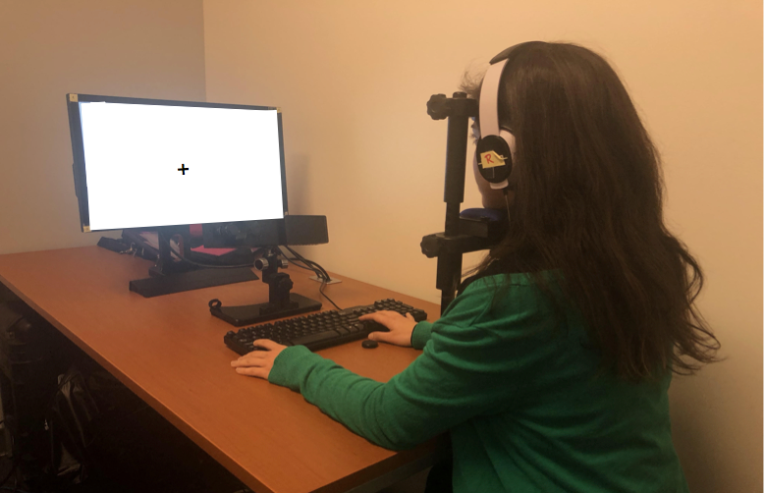

Slide 14
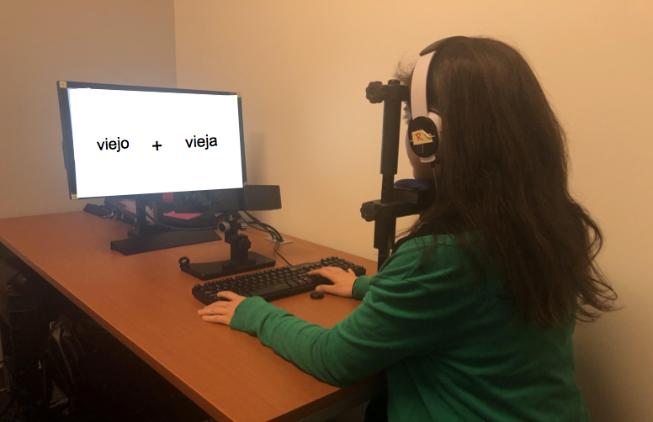
canta cantó
14

Slide 15
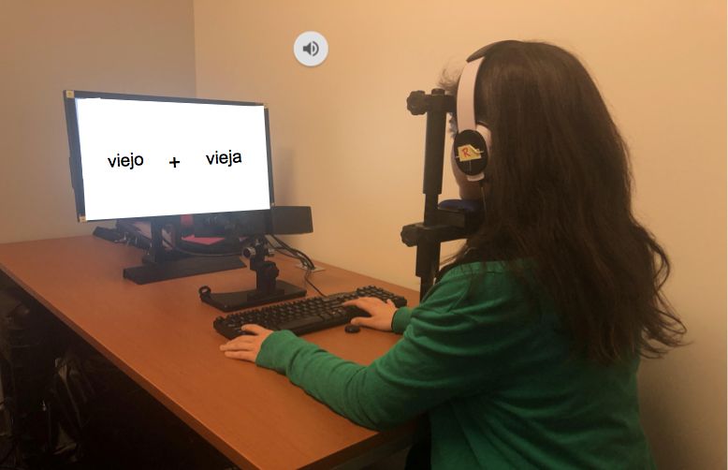

canta cantó

Slide 16

canta canto

Slide 17
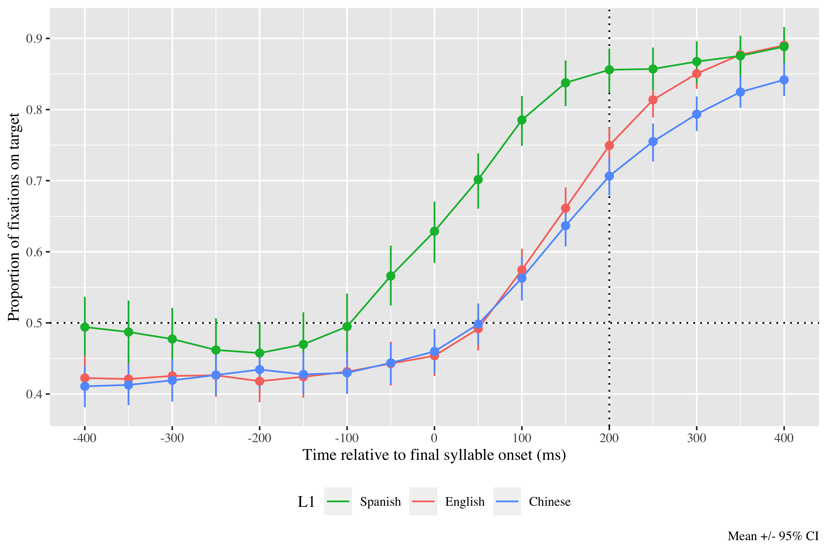
Results Timecourse
can.ta
17
Notes:
In this first graph, we can see the pattern of fixations before exploring relationships.
On the horizontal axis…

Slide 18
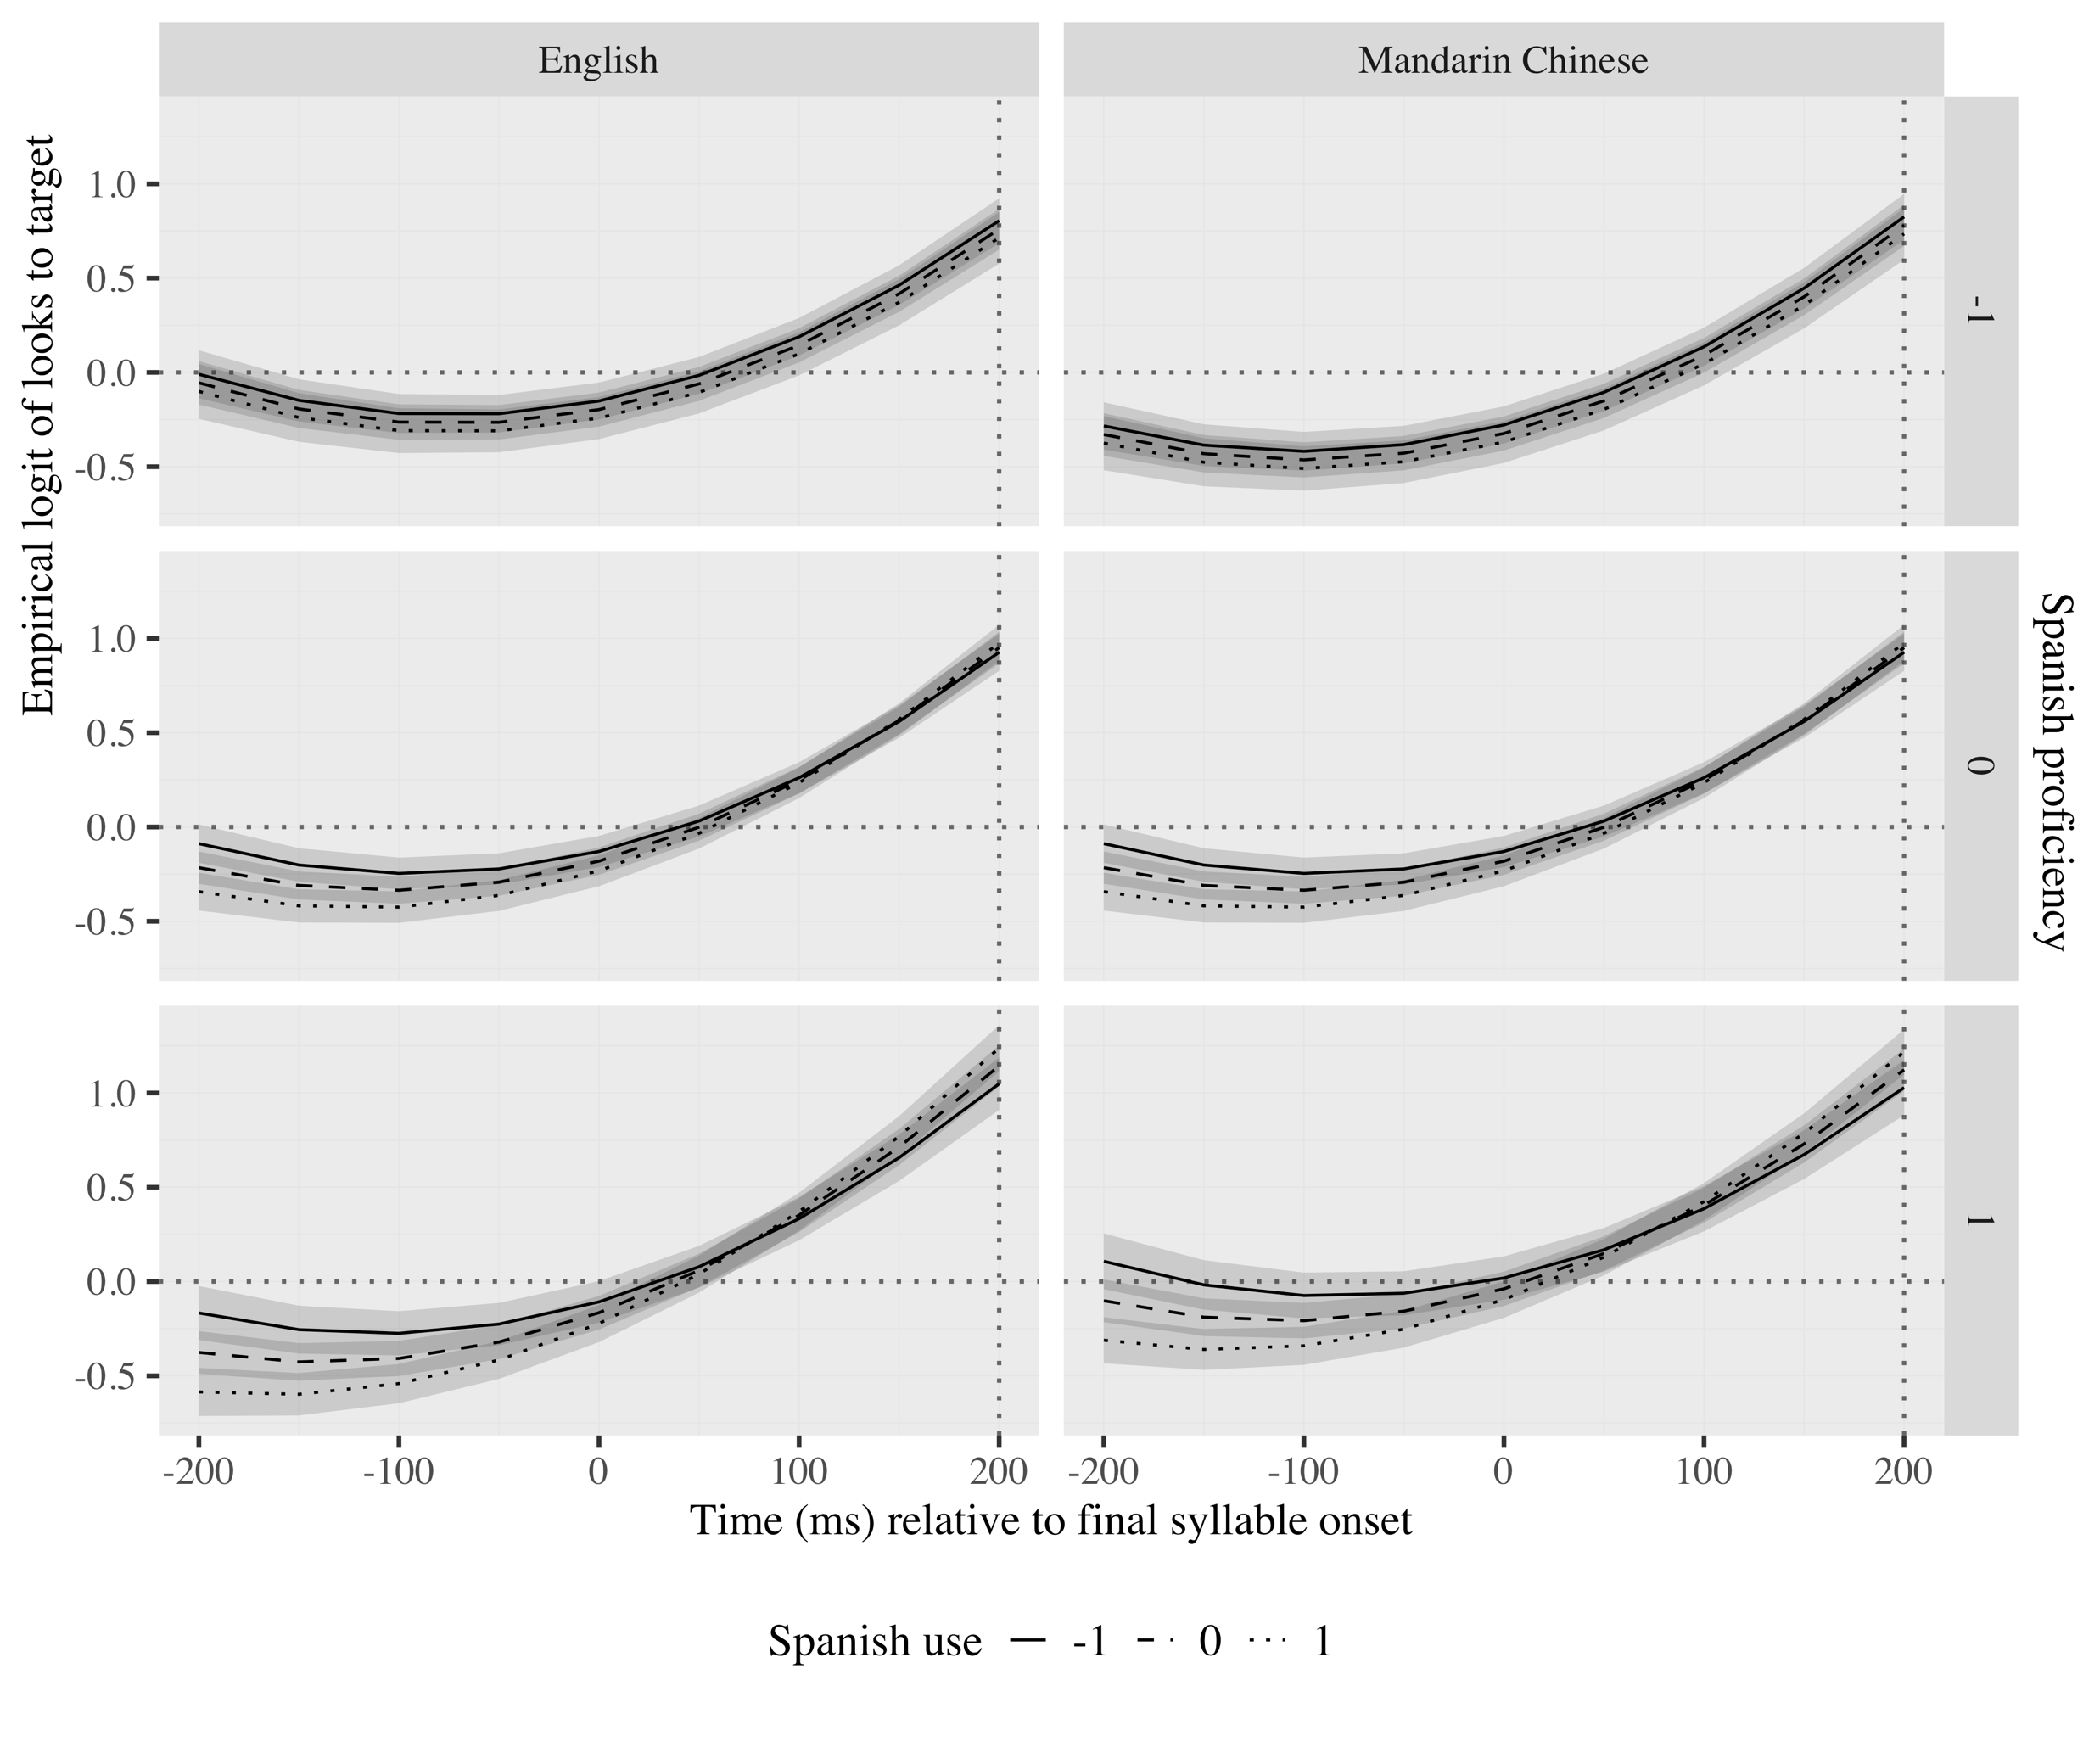
Results
English
Mandarin Chinese
Notes:
All populations generated predictions, although L2 less and later than monolinguals. Monolinguals are not included here as they were the control group and the language experience variables did not apply to them.
Stress patterns, L2 proficiency and L2 use were the primary mediators of prediction in L2 speakers. These factors interacted with each other as well as with L1 transfer. Proficiency interacted with L1, such that particularly Chinese speakers predicted more target-like and earlier as proficiency increased. L2 use interacted with L1, such that especially the English speakers predicted faster with more L2 use.
_______________
All populations generated predictions. Stress pattern, L2 proficiency and L2 use were the primary mediators of prediction in L2 speakers. [Oxytones were predicted earlier and more target-like than paroxytones, higher proficiency resulted in more target-like and earlier predictions, and more extensive L2 use contributed to faster predictions.] These factors interacted with each other as well as with L1 transfer. Proficiency interacted with [stress, such that proficiency resulted in more target-like predictions of oxytone, and with] L1, such that its positive effects were particularly relevant in Chinese speakers–more target-like and earlier. L2 use interacted [with stress, such that speed of prediction increased especially with L2 use especially in paroxytones, and] with L1, such that especially the English speakers benefited from more L2 use–faster. L2 proficiency and L2 use also interacted; at a high level of proficiency, prediction became faster as use was more frequent. L2 proficiency and L2 use were positively and moderately correlated.

Slide 19
Discussion
L2 proficiency and L2 use have distinct effects
Usage-based models (Bates & MacWhinney, 1982; Ellis, 2006)
Consequences in the brain models (Del Maschio et al., 2020)
L1 interacts with L2 experience
Cross-linguistic transfer models (Bates & MacWhinney, 1982; Schwartz & Sprouse, 1994)
Lexical models of spoken word recognition (Hopp, 2015; Patterson et al., 2017; Kaan, 2014)
Utility of prediction (Kaan & Grüter, 2021; Kuperberg & Jaeger, 2016 )
Notes:
The first two studies in my dissertation…

Slide 20
STUDY 3: ASSOCIATION BETWEEN VISUOSPATIAL PREDICTION AND LINGUISTIC PREDICTION
Notes:
In my third study, I wanted to investigate whetherTHE WAY WE PREDICT IN ONE COGNITIVE DOMAIN (E.G., VISUOSPATIAL) IS ASSOCIATED WITH THE WAY WE PREDICT IN ANOTHER COGNITIVE DOMAIN (E.G., LINGUISTIC). THIS IS IMPORTANT for theories of cognition BECAUSE DOMAIN-SPECIFIC THEORIES CLAIM THAT COGNITIVE DOMAINS ARE INDEPENDENT FROM EACH OTHER, WHEREAS DOMAIN-GENERAL THEORIES ARGUE THAT ALL DOMAINS ARE RELATED TO EACH OTHER.

Slide 21
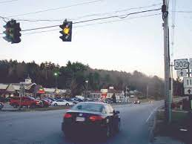
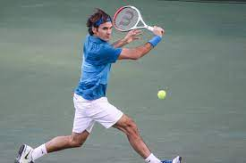
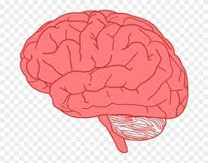


Domain-general models
Domain-specific models
Notes:
A lot of prediction research in language has examined prediction in language, however, recent neurocognitive research, for instance, indicates that predictive mechanisms may be shared across cognition. I therefore wanted to explore how language prediction relates to prediction in other non-language skills.
Domain-specific no transfer because skills too specific
Domain general transfer across domains is possible if the domains share common features (Thorndike & Woodworth, 1901) and cognitive elements (Anderson, 1990).
Most previous research on e.g., chess or playing videogames suggest no transfer bc skills too specific. However, prediction is a more general mechanism that is used in more than one cognitive domain/skill.
Models of learning:
Domain-specific models of learning (Ericsson & Charness, 1994; Gobet, 2015)
Domain-general models of learning (Anderson, 1990; Thorndike & Woodworth, 1901)
We make predictions when:
Playing sports (e.g., Bishop et al., 2013; Wimshurst et al., 2016)
Driving (e.g., Morando et al., 2016; Yamani et al., 2018)
Listening to music (e.g., Huron, 2016)

Slide 22

Research on vision/space ~ language
Prediction:
Deixis as a cue to prediction in adults (Reuter et al., 2021)
Visuospatial expectations updated faster in children the larger their vocabulary (Reuter et al., 2018)
Notes:
LAURA,WHAT HAPPEN W THIS COMMENT I MADE BELOW? CAN YOU INCORPORATE IT? Creía que te referías a los dos primeros bullet points, que los había quitado para ahorrar tiempo. Si no son esos, no sé a qué estudios te refieres.
ADD STUDIES SHOWING ASSOCIATION BW SEVERAL COGNITIVE DOMAINS IN PROCESSING. THEN SAY NO STUDY HAS INVESTIGATED THIS ASSOCIATION IN PREDICTION. THEN WHY THIS IS IMPORTANT.

Slide 23
Participants
30 native Spanish speakers
Materials
Same as in Studies 1 and 2
Visuospatial prediction task
Notes:
A group of 30 monolingual speakers of Spanish completed the same eye-tracking task as before to measure their ability in language prediction and a time/movement anticipation task to measure their ability to make trajectory predictions based on speed and distance information

Slide 24
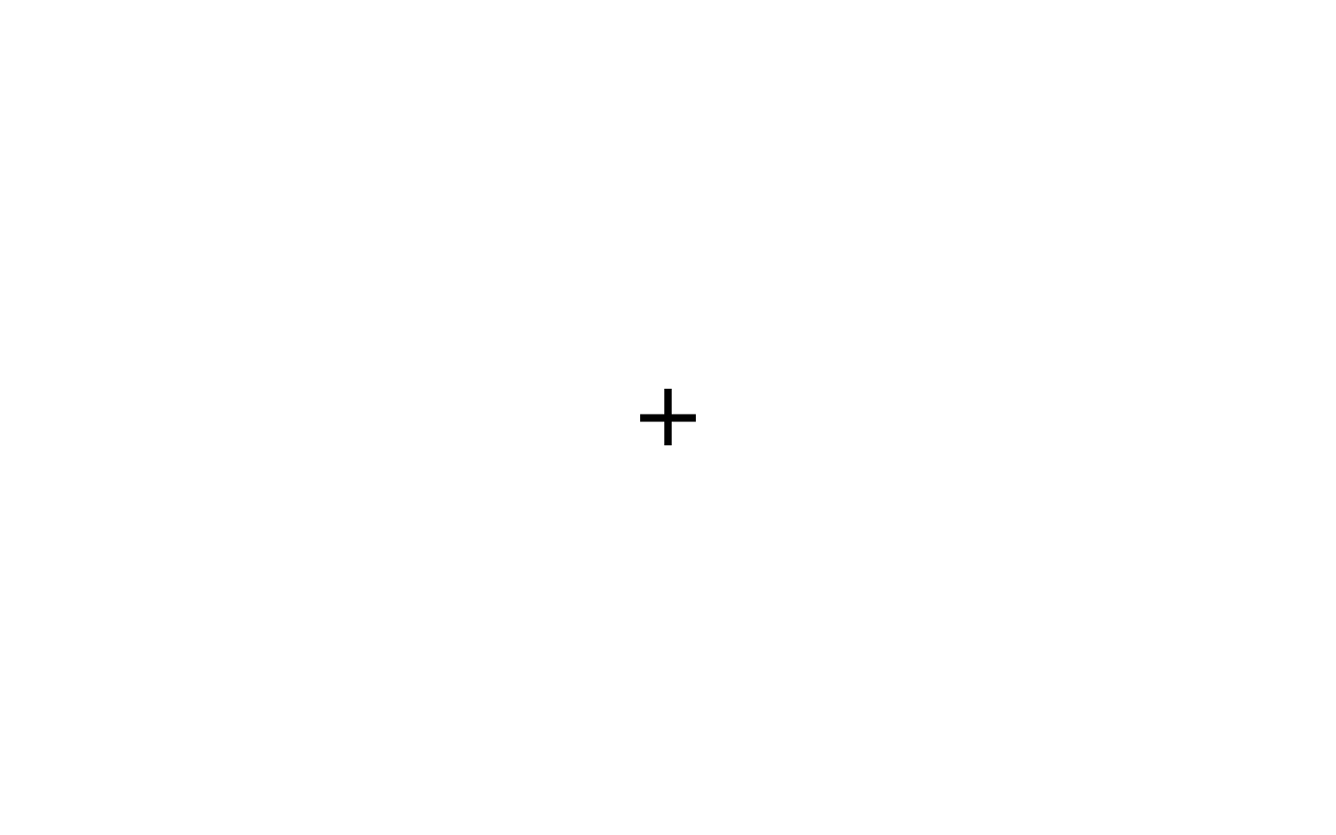

Slide 25
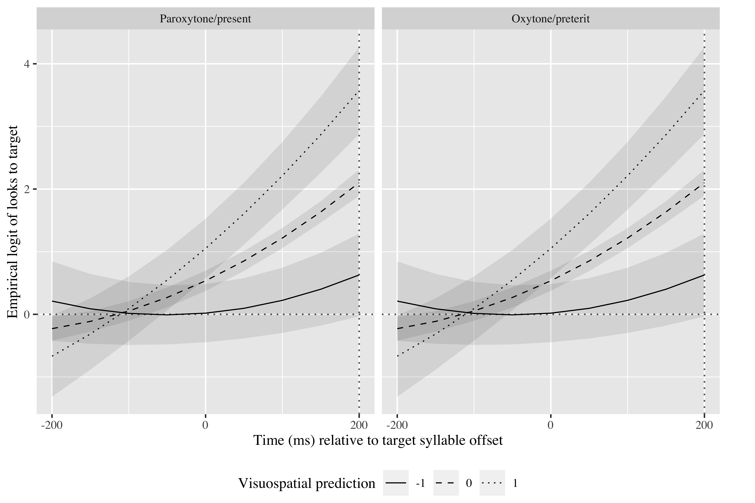
Results
Canta
Cantó
Notes:
The data revealed that speakers were predicting in both domains, and that verbal and visuospatial prediction were associated, such that a shorter deviation time in visuospatial prediction was associated with faster spoken word prediction.

Slide 26
Discussion
Findings support:
Domain-general models of learning (for more general mechanisms)
Neural reuse theories (Asano et al., 2021)
Neuroemergentist approach (Hernández et al., 2019)
Notes:
domain-general models for prediction, However, the finding does not completely support domain-general accounts arguing that the information shared needs to be both perceptual and conceptual (Singley & Anderson, 1989).

Slide 27
Conclusion
Distinct language experiences shape language processing and prediction differently
Need to heed language use more closely
Prediction abilities may share common mechanisms across cognition

Slide 28

Future research
Other language pairs for cross-linguistic transfer
Other morphophonological associations
Association between language and non-language prediction in bilinguals
Association between language and music prediction

Slide 29

Pedagogical implications
Importance of teaching L2 prosody
Expanding real life situations in which L2 learners use the L2
Training prediction through other associations

Slide 30
Thank you.
+
Notes:
Acknowledgments

